Slide 1
Weather GUI using Python
Gitika Sunam : 69
Kavita Sharma : 66
Mubarak Khalife: 30
Russell Fernando: 17
Guided by: Prof. Nitin Ahire

Slide 2
Block diagram :
Data Server
API
Receive Data
Output
Analysis
Pre-Processing

Slide 3
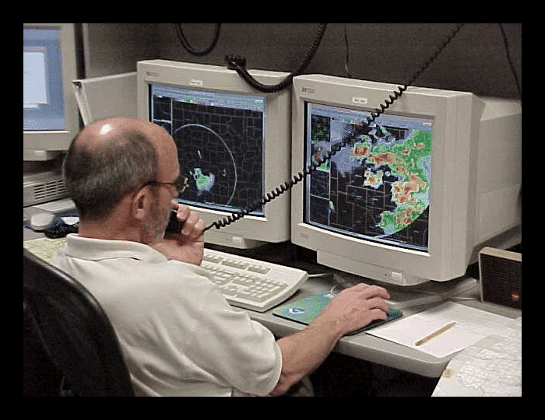
Collecting Weather Data

Slide 4
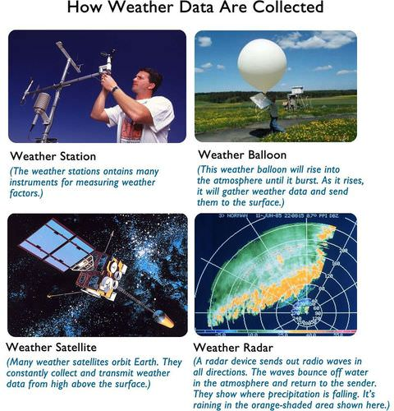

Slide 5
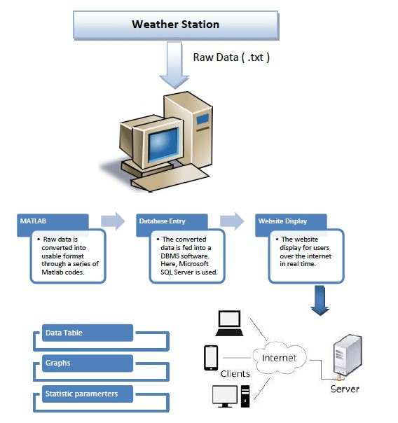
How do we get the data from weather station ?

Slide 6
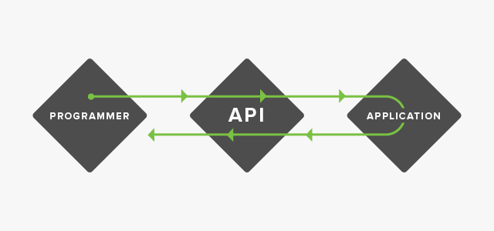
API (Application Programming Interface) :
API stands for application programming interface. This is a concept in software technology that essentially refers to how multiple applications can interact with and obtain data from one another. APIs operate on an agreement of inputs and outputs.

Slide 7
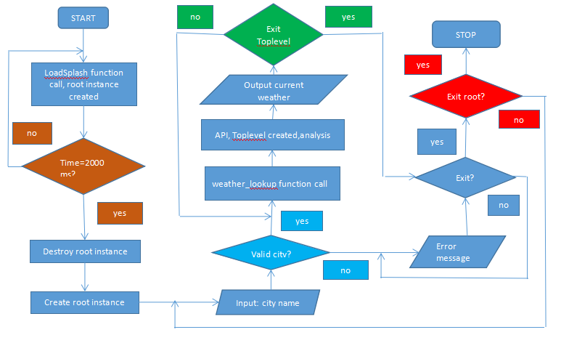
Flow Chart of the code :

Slide 8
ADVANTAGES/APPLICATIONS :
Easy of data access
Agriculture
Transport
Tourism

Slide 9
TOOLS/SOFTWARE REQUIRED:
Python
API

Slide 10
THANK YOU!!!!

